Slide 1
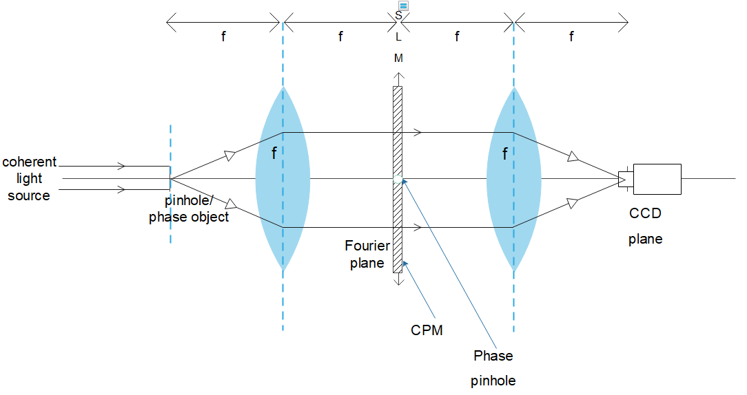
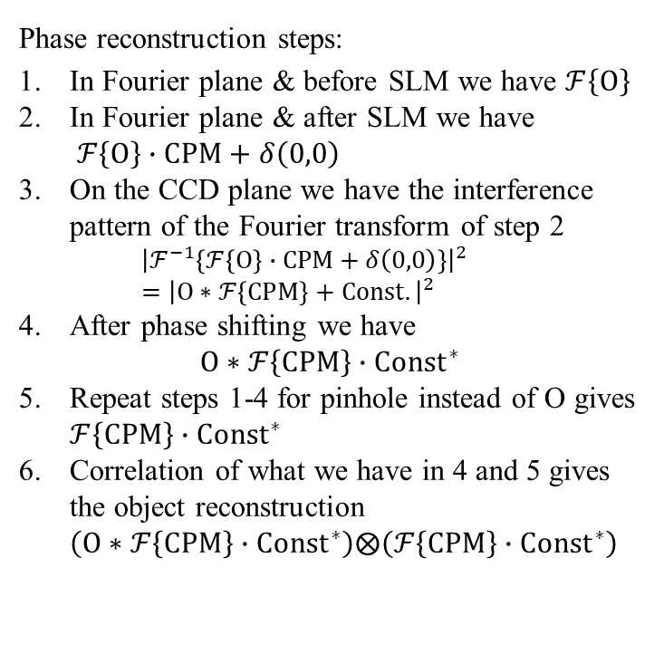
Coherent COACH Phase Imaging
Single channel 4-f system with phase mask pinhole
Phase reconstruction steps:
In Fourier plane & before SLM we have $ℱ\left\{O\right\}$
In Fourier plane & after SLM we have $ℱ\left\{O\right\}∙CPM+δ\left(0,0\right)$
On the CCD plane we have the interference pattern of the Fourier transform of step 2 ${\left|ℱ^{−1}\left\{ℱ\left\{O\right\}∙CPM+δ\left(0,0\right)\right\}\right|}^{2}={\left|O∗ℱ\left\{CPM\right\}+Const.\right|}^{2}$
After phase shifting we have $O∗ℱ\left\{CPM\right\}∙{Const}^{∗}$
Repeat steps 1-4 for pinhole instead of O gives $ℱ\left\{CPM\right\}∙{Const}^{∗}$
Correlation of what we have in 4 and 5 gives the object reconstruction $\left(O∗ℱ\left\{CPM\right\}∙{Const}^{∗}\right)⨂\left(ℱ\left\{CPM\right\}∙{Const}^{∗}\right)$

Slide 2
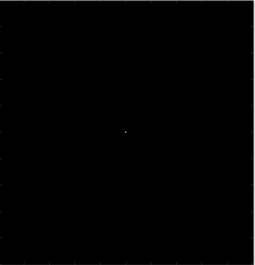
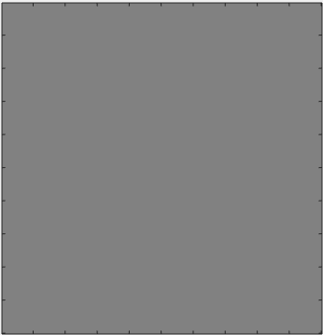
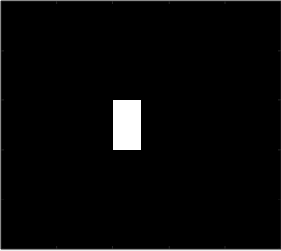
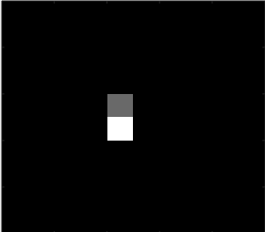
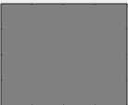
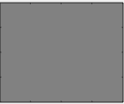
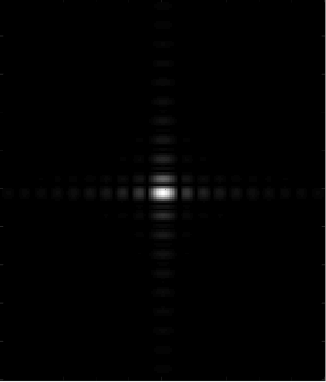
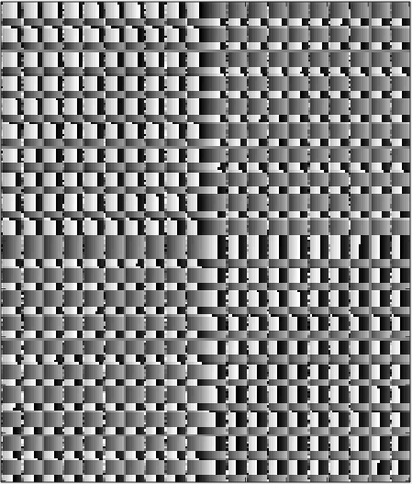
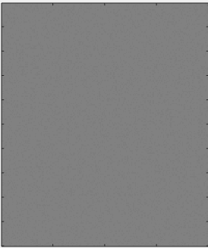
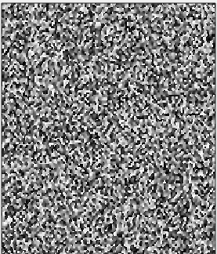
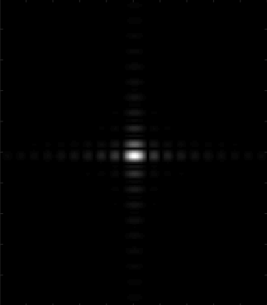
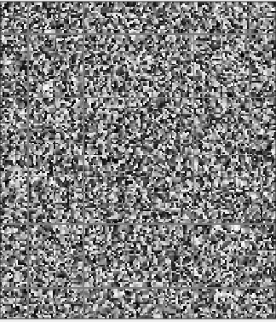
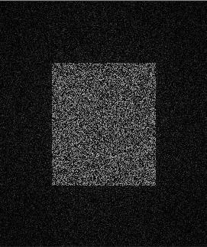
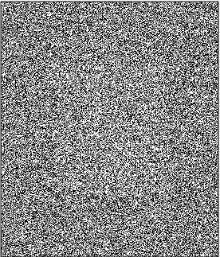
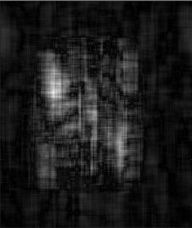
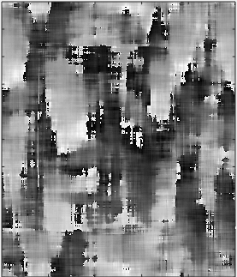
Coherent COACH Phase Imaging
Single channel 4-f system with phase mask pinhole, intermediate stages
Object | Pinhole | Record Plane of interest
 |  | Object plane
 |  | Fourier plane, before SLM *cropped snapshot: central [200,200] pixels out of [1000,1000] pixel total space*
 |  | Fourier plane, after SLM *cropped snapshot: central [200,200] pixels out of [1000,1000] pixel total space*
 |  | CCD plane (no reference wave)
Amp
Phase
Amp
Phase
Amp
Phase
Amp
Phase
Amp
Phase
Amp
Phase
Amp
Phase
Amp
Phase

Slide 3
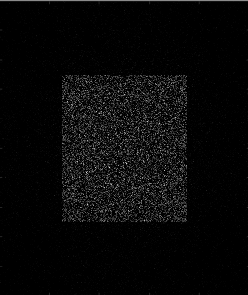
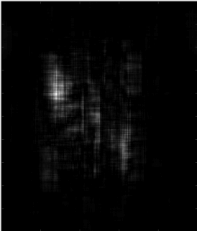
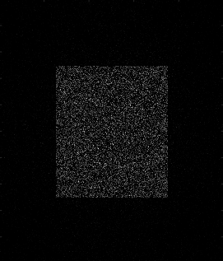
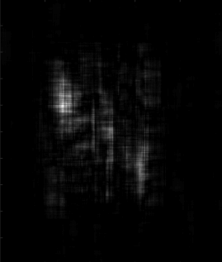
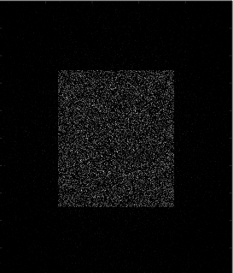
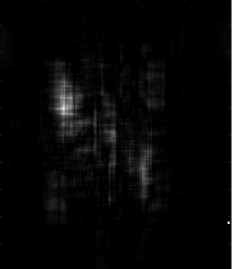
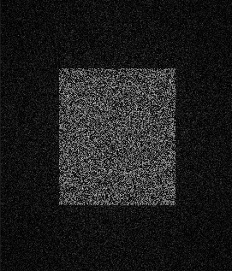
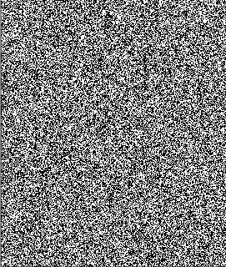
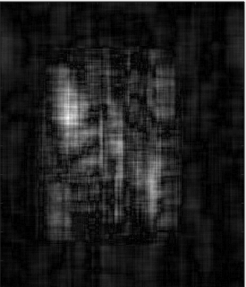
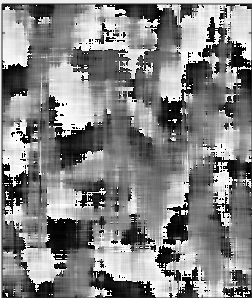
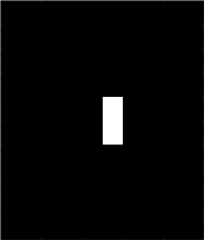
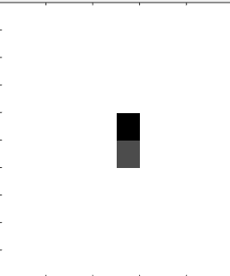
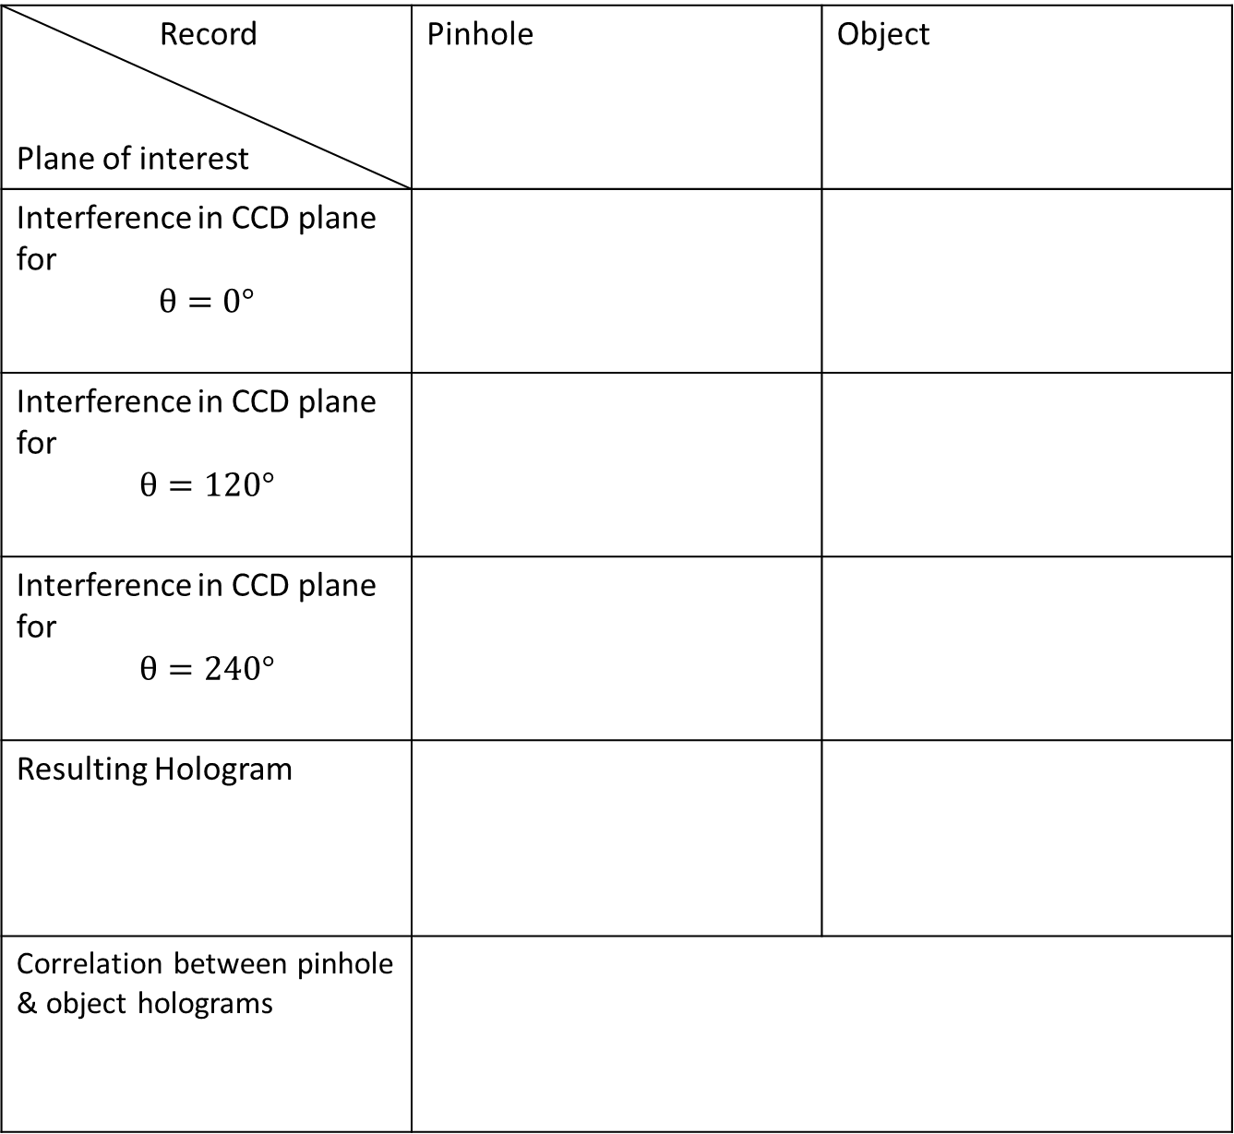
Coherent COACH Phase Imaging
Single channel 4-f system with phase mask pinhole, phase shifting procedure (CPM peripheral shifted)
Object | Pinhole | Record Plane of interest
 |  | Interference in CCD plane for $$θ=0°$$
 |  | Interference in CCD plane for $$θ=120°$$
 |  | Interference in CCD plane for $$θ=240°$$
 |  | Resulting Hologram
 |  | Correlation between pinhole & object holograms
Amp
Phase
Amp
Phase
Amp
Phase

Slide 4
Coherent COACH Phase Imaging
Dual channel 4-f system, initial results
Object size=[200,100] pixels
Object Amp = random
MSE = 0.11

Slide 5
Coherent COACH Phase Imaging
Dual channel 4-f system, initial results
Object size=[400,400] pixels
Object Amp = 1
MSE = 0.1

Slide 6
Coherent COACH Phase Imaging
Dual channel 4-f system, initial results
Object size=[400,400] pixels
Object Amp = 1
MSE = 1.07

Slide 7
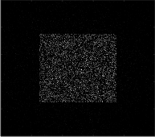
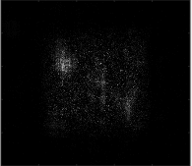
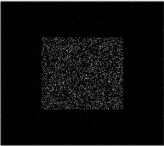
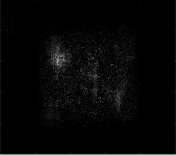
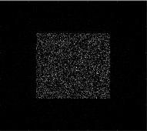
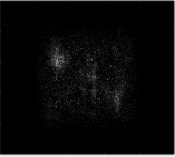
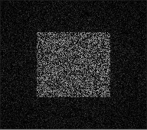
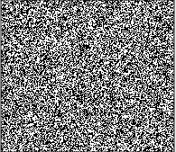
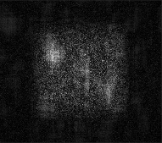
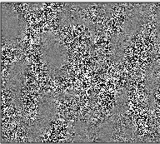
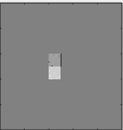
Coherent COACH Phase Imaging
Single channel 4-f system with phase mask pinhole, phase shifting procedure (CPM pinhole shifted)
Object | Pinhole | Record Plane of interest
 |  | Interference in CCD plane for $$θ=0°$$
 |  | Interference in CCD plane for $$θ=120°$$
 |  | Interference in CCD plane for $$θ=240°$$
 |  | Resulting Hologram
 |  | Correlation between pinhole & object holograms
Amp
Phase
Amp
Phase
Amp
Phase

Slide 8
Coherent COACH Phase Imaging
Dual channel 4-f system, initial results
Object size=[200,100] pixels
Object Amp = random
MSE = 0.11

Slide 9
Coherent COACH Phase Imaging
Dual channel 4-f system, initial results
Object size=[400,400] pixels
Object Amp = 1
MSE = 0.09

Slide 10
Coherent COACH Phase Imaging
Dual channel 4-f system, initial results
Object size=[400,400] pixels
Object Amp = 1
MSE = 1.06

Slide 11
Coherent COACH Phase Imaging
Dual channel 4-f system, 3D object
z=f-δ
z=f-δ
MSE = 0.15
MSE = 0.14
z=f+δ
δ =1mm
MSE = 0.09

